Slide 1


CONVERSATIONAL BOTS : CHAT BOTS
DONE BY
SUPRAJA.G.D
KURUSHITH VEDHA.J

Slide 2
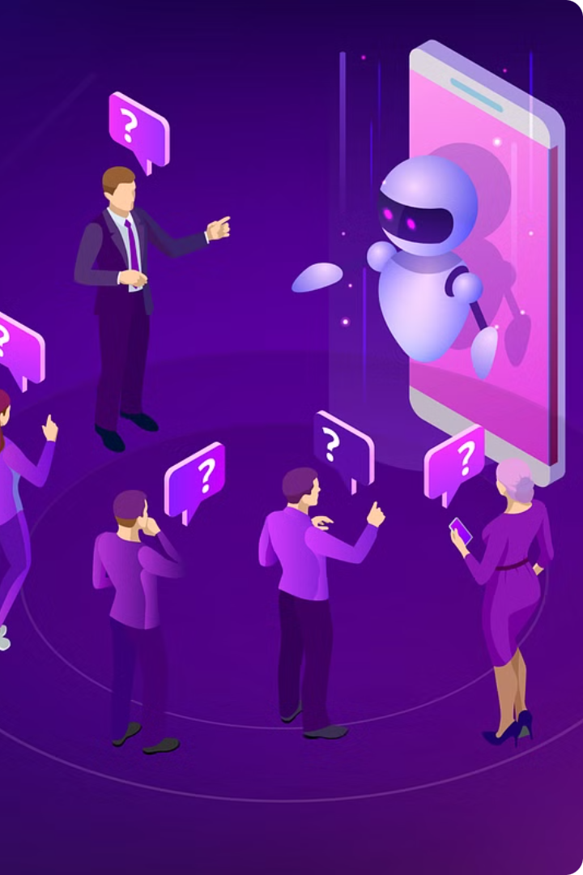
Introduction to Conversational Bots
Conversational bots, also known as chatbots, are intelligent software applications that can engage in natural language conversations with users. These bots are powered by advanced natural language processing (NLP) and machine learning technologies, enabling them to understand, interpret, and respond to human queries in a seamless and contextual manner.

Slide 3
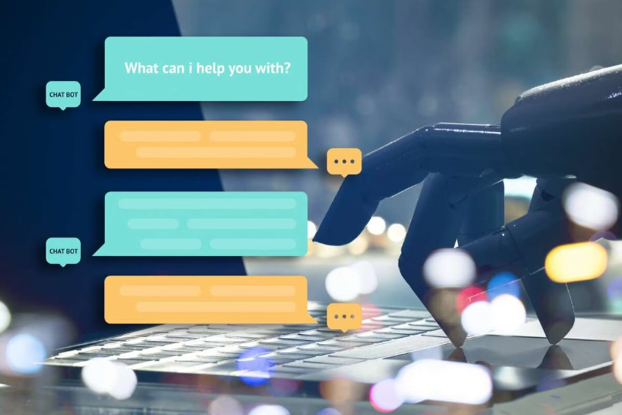
What are Chatbots?
Chatbots are conversational artificial intelligence (AI) programs designed to simulate human-like dialogue. They use natural language processing (NLP) to understand user input and provide relevant, contextual responses.
Chatbots can be deployed on various platforms like websites, messaging apps, or voice assistants to automate customer service, provide information, and enhance user engagement.

Slide 4
Benefits of Chatbots
Improved Customer Experience
Increased Efficiency
Cost Savings
Data-Driven Insights
Deploying chatbots can significantly reduce operational costs by automating customer service and support functions.
Chatbots can handle high volumes of customer inquiries and streamline routine tasks, freeing up employees to focus on more complex issues.
Chatbots collect valuable customer data and behavior patterns, enabling businesses to make data-driven decisions.
Chatbots provide instant, personalized assistance 24/7, improving customer satisfaction and reducing wait times.

Slide 5
Types of Chatbots
Rule-Based Chatbots
AI-Powered Chatbots
These chatbots use a predefined set of rules and decision trees to respond to user inputs. They have limited conversational abilities but are simple to build.
Powered by natural language processing and machine learning, these chatbots can understand context, engage in deeper conversations, and continuously learn from interactions.
Hybrid Chatbots
Specialized Chatbots
Combining rule-based and AI-powered approaches, these chatbots leverage the strengths of both to provide a more versatile and intelligent conversational experience.
Designed for specific tasks or industries, these chatbots are highly focused and can provide expert assistance in areas like customer service, e-commerce, or healthcare.

Slide 6

Key Components of a Chatbot
Natural Language Processing (NLP)
1
Enables the chatbot to understand and interpret human language, allowing for natural conversation.
2
Dialogue Management
Determines the appropriate responses based on the user's input and the chatbot's conversational goals.
Knowledge Base
3
Stores information, facts, and rules that the chatbot can access to provide relevant and informative responses.

Slide 7
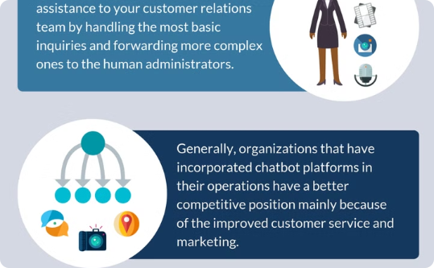
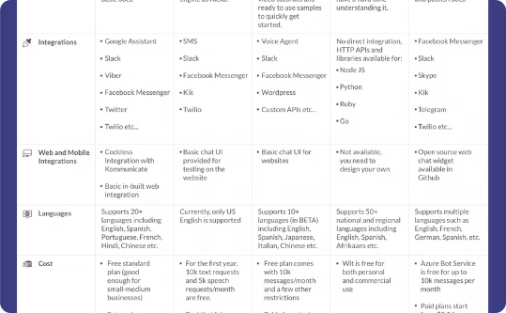
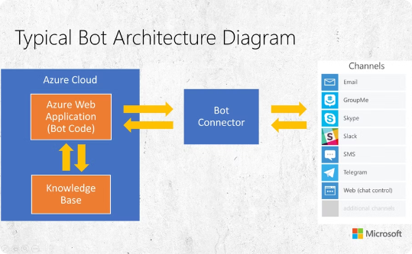
Chatbot Development Platforms
Dialogflow
Amazon Lex
Microsoft Bot Framework
Dialogflow, a Google-owned platform, enables intuitive conversational experiences across multiple channels like web, mobile, and messaging apps.
Amazon Lex is a fully managed AI service that allows developers to build conversational interfaces into any application using voice and text.
The Microsoft Bot Framework helps developers build, connect, test, and deploy high-quality bots for a wide variety of channels, including Teams, Slack, and Facebook Messenger.

Slide 8



Conversational Design Principles
Natural Conversation
Personality
Empathy
Imbue your chatbot with a distinct personality - one that is relatable, consistent, and aligned with your brand identity to build trust and connection.
Demonstrate empathy by understanding the user's intent, emotions, and needs, and providing responses that are caring, supportive, and tailored to the individual.
Design chatbots that engage in natural, human-like dialogue, responding appropriately to user input and providing helpful, contextual information.

Slide 9
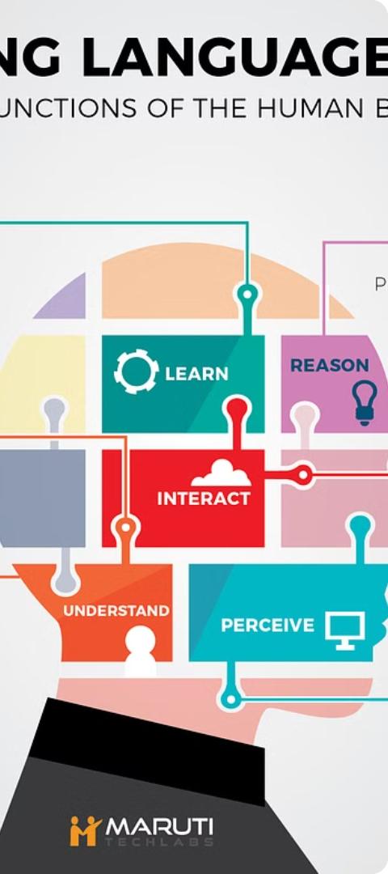
Natural Language Processing (NLP) in Chatbots
1
Speech Recognition
2
Intent Detection
Chatbots leverage advanced speech recognition algorithms to interpret and respond to users' spoken language, enabling natural voice-based interactions.
NLP models analyze user input to detect the underlying intent, allowing chatbots to understand the meaning behind the words and provide relevant responses.
3
Sentiment Analysis
Chatbots can use NLP techniques to gauge the user's emotional state and adjust their tone and responses accordingly, creating a more empathetic interaction.

Slide 10
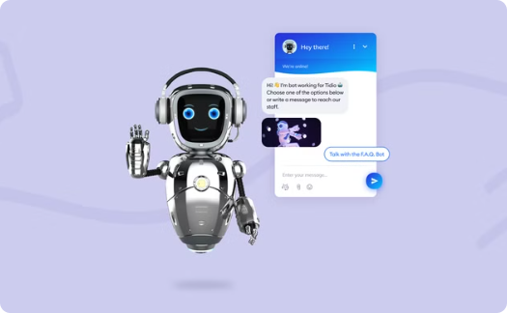
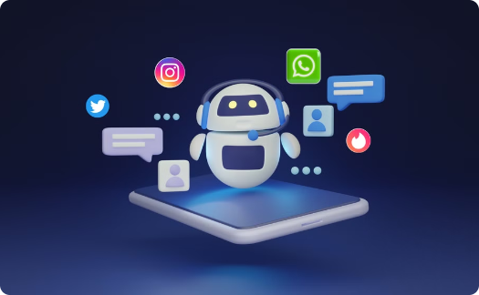
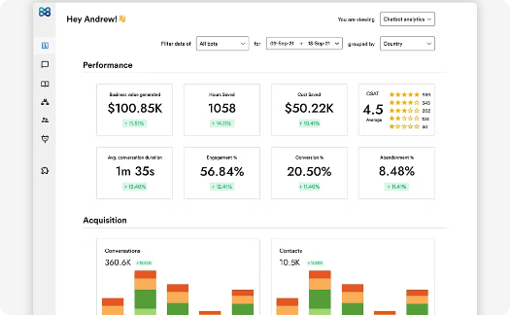
Integrating Chatbots with Business Applications
Streamlined Workflows
Improved Customer Experience
Actionable Insights
Chatbots can seamlessly integrate with a company's existing business applications, automating repetitive tasks and enhancing productivity across the organization.
Chatbot interactions generate valuable data that can be analyzed to uncover trends, identify pain points, and inform strategic business decisions.
By tapping into customer data and business systems, chatbots can provide personalized, context-aware assistance to customers, improving satisfaction and loyalty.

Slide 11
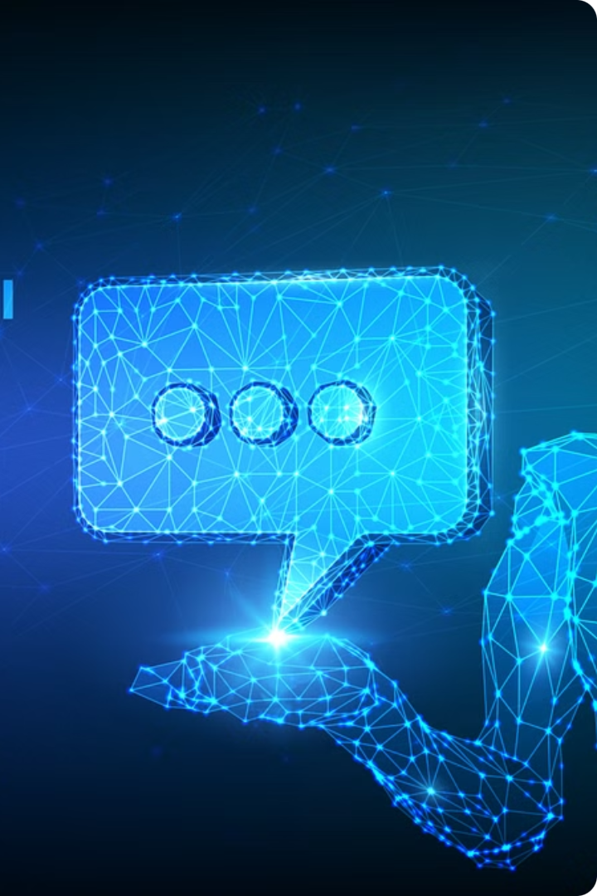
Future Trends in Conversational AI
As artificial intelligence and natural language processing continue to advance, the future of conversational AI holds exciting possibilities for enhanced user experiences and increased business applications.

